Slide 1
Virtusa Project

Slide 2
Issue Management System
G. Mani Sankar
K. Rehmathulla

Slide 3
Agenda
Login Page
Main page-Issue Management page:
Register Issue
Check Status
Logout
Register Issue –Type of Issues
Check Status-Status of the Application
Logout

Slide 4
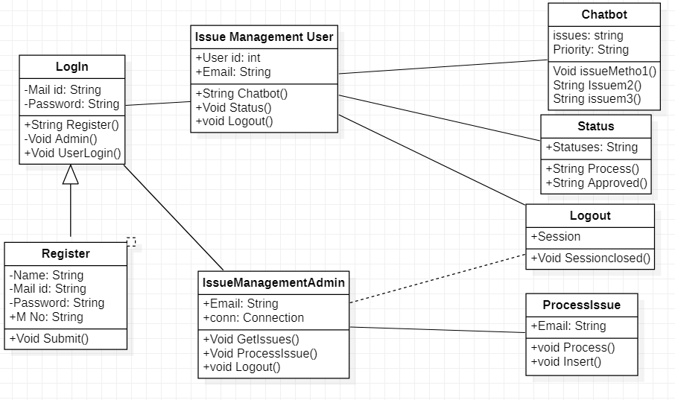
Class Diagram

Slide 5
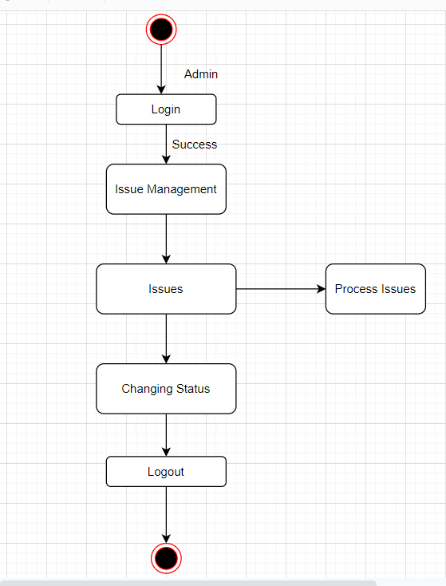
State Diagram: Admin

Slide 6
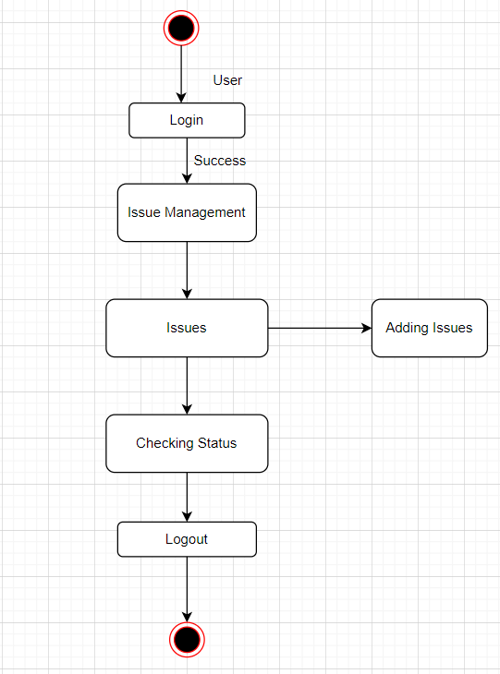
State Diagram: User

Slide 7
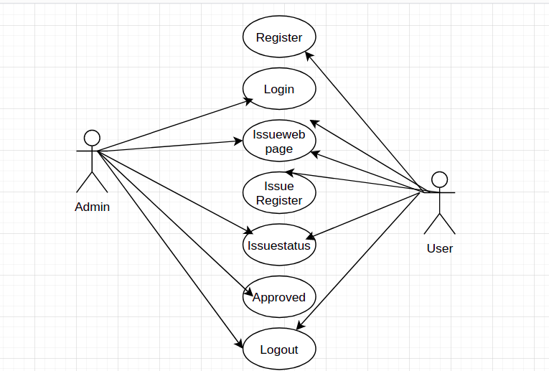
Use-Case Diagram

Slide 8
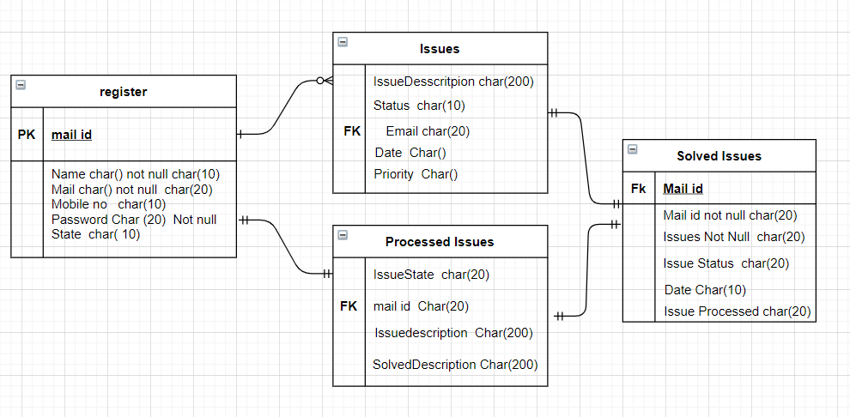
ER-Diagram

Slide 9
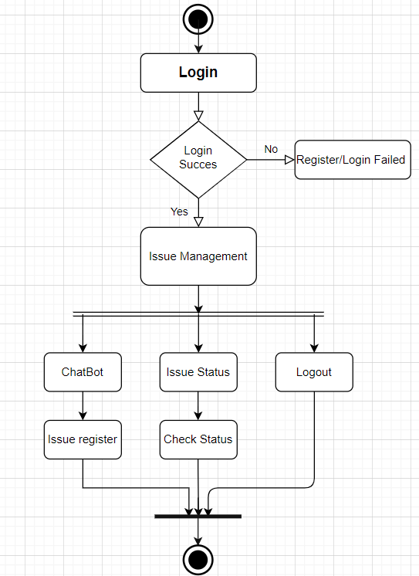
Activity Diagram

Slide 10
Time Line
Saturday
Login Page
Issue Management Main Page
Sunday
Status Page
Chat bot
Total Issues Page
Logout

Slide 11
Thank You

